Slide 1



Naming & Framing
Preparing Local Dialogue Resources
CIVIC & Racial Understanding IST
Gainesville, FL
February 26, 2019

Slide 2
A Problem is Suited for Public Deliberation When…
The issue is of broad concern to the community.
There is a decision that must be made about the issue.
There is lack of agreement about what is at issue.
There is disagreement on the cause of the problem, or the cause is not clear.
There is no definitive or single solution to the problem, but a decision needs to be made about what may be done.
Every solution involves trade-offs or downsides that involve things held valuable.
The problem is intractable, ongoing, or systemic.
People will face moral disagreements in deliberating on the issue.
Any solution will take multiple actors (e.g., community groups, individuals, and government).

Slide 3
Framing Team Roles
Someone who can write clearly and evenhandedly, constructing a good argument and avoiding jargon.
Someone who can substantively research the problem.
Someone knowledgeable about public opinion, its use, and limitations.
Someone in touch with community perspectives.
Someone who has experience in framing issues for public deliberation.

Slide 4
Naming
Community problems are “named” as ordinary people talk about what concerns them while standing in the grocery line, sitting in the bleachers, chatting after a concert, or having conversations with neighbors.
Discovering how people describe local issues simply involves asking people to share their concerns.

Slide 5
Concern Gathering
One-to-one interviews
Formal surveys
Focus groups
Listening to casual conversations.

Slide 6
Concern Gathering Questions
Handout – Concern Gathering Survey
Keep questions simple and broad.
  When you think about this topic what concerns you? What bothers you most personally?
  What concerns do you hear your friends and family members – or others you don’t know well – talking about when it comes to this topic?
  Why is this issue important for our community?

Slide 7
Examining Concerns & Creating Options
Gather all the concerns and list them on large flipcharts.
  For each concern ask, “What is the thing held valuable behind this concern?”
  For example, safety, education, justice, care for the vulnerable, health, self reliance, etc.
Look for themes and create categories for the concerns.
Endeavor to integrate the themes into three options.

Slide 8
Reconsider the Issue Name
After examining the concerns and determining options, the naming and framing team will have a better idea how to finalize the name for the issue.
Example
  Initial concern-gathering title. What Should We Do About Jacksonville’s Confederate Monuments?
  Issue guide draft: What Does it Mean to be a Bold City?
  Final Name: How Should We Convey the History of Jacksonville? Monuments, Parks, & People.

Slide 9
Describing the Options
Three key questions:
  What concerns you about this issue?
  Given those concerns, what would you do about it?
  If that worked to ease your concerns, what are the downsides or trade-offs you might then have to tolerate?
    Answers to these questions offer a good starting place to introduce the option in the issue guide. “People who favor this option are most concerned about….They want to address the problem by….They are willing to give up or trade off….in order to move forward.”

Slide 10
Option Examples
Knowledge - What could be done to better educate people?
Organization – What could be done to bring people and organizations together to address this community issue?
Fairness – How will we make sure people are not negatively impacted while we solve this problem?
Each option needs a name that reflects the underlying value of the actions.
Try to identify four or five actions and corresponding drawbacks for each option.

Slide 11
Actions & Drawbacks
Action: Beef up and expand the use of neighborhood crime watch programs.
Drawback: This might erode community trust and neighbors could end up targeting people based on racial, ethnic, or religious biases.
Key Questions
  Is this action clear?
  Who would do it?
  Does it respond directly to the main concern of this option?
  Does the drawback assume the action works? Drawbacks require that we put on our “opposite hats” and think about those who oppose the action or general option.

Slide 12
Issue Guides
Five Elements
  A Title that reflects the inherent tension in the issue
  An Introduction that explains the issue and why something should be done about it.
  Descriptions of each Option for dealing with the issue.
  An Option Subsection providing examples of what could be done or Actions.
  A Second Subsection including examples of Drawbacks or Tradeoffs for each action.

Slide 13
Writing the Issue Guide
Issue guides can be as simple as a table mat size piece of paper with an introduction to the issue and the three options with their actions and drawbacks.
Most issue guides provide a fair and balanced description of the issue with some graphic material. The underlying question is, “What should we do about this issue?”
Prepare a brief introduction for each option. ”This option might appeal to people who are concerned about the fiscal health of the community….”
List the actions and drawbacks.
Encourage participants to reflect on their deliberation of the three options. Provide a series of questions focused on the possibility of discerning some agreement or common ground.

Slide 14
A good dialogue framing resource to use for water-related. Issues in your community.
Lara Milligan can speak to this issue guide.

Slide 15
Five-part Issue Framework
Five parts of a deliberative issue framework After completing this process, you’ll have a water issue framework with five parts. Parts 1 & 2 Part 3 Parts 4 & 5 | Through these steps, you’ll complete five parts of an issue framework and finish with a simple guide that you can use to structure deliberative forums. 1. Title 2. Introduction that explains the issue 3. Descriptions of each of three or four options (strategies) for dealing with the is- sue—including potential downsides to taking that approach 4. Examples of actions that fit with each option 5. Examples of drawbacks or tradeoffs to each action
Issue Title & Description
Option 1 | Option 2 | Option 3
Action Example &Tradeoff Action Example &Tradeoff Action Example &Tradeoff Action Example &Tradeoff Action Example &Tradeoff | Action Example &Tradeoff Action Example &Tradeoff Action Example &Tradeoff Action Example &Tradeoff Action Example &Tradeoff | Action Example &Tradeoff Action Example &Tradeoff Action Example &Tradeoff Action Example &Tradeoff Action Example &Tradeoff

Slide 16
Reflection
Having given equal time to each of the options, did you sense there were any specific areas of agreement? Did we discover any common ground?
Could you identify particular tensions where more information and dialogue would be beneficial?
Who was not at the table?
What recommendations might we agree on conveying to community decision-makers?

Slide 17
Post-forum Questionnaire
Creating a questionnaire with Likert Scale responses and open-ended questions provides individuals with a way to anonymously respond to the forum experience.
CIVIC provided a pre and post-forum questionnaire for last evening’s deliberative forum.

Slide 18
Naming & Framing Practice Session
How should extension agents take advantage of community resources to advance their work?
Four Steps
2:00-2:15 - Gather concerns in small groups. Think of what others might say when surveyed. Use Capturing Community Views handout. List concerns on flipcharts.
2:15-2:35 - In large group review lists of concerns and identify categories. Narrow down to three approaches.
2:35 -2:55 - Return to small groups. Each group take an approach and develop possible actions with corresponding drawbacks.
2:55-3:10 - Large group reviews the rough draft of a dialogue resource.

Slide 19
Extension Agents will maximize community Resources by…
Mitigating tribalism and seeking recognition
Improving community perception of Extension agents’ work and affiliations
Raising resources to strengthen community collaborations.

Slide 20
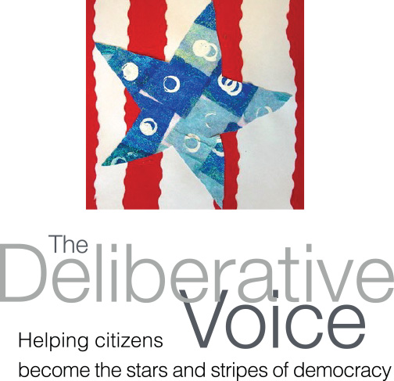
Contact
Rev. R. Gregg Kaufman
4210 Eagle Landing Parkway
Orange Park, FL 32065
gkaufman8@mac.com
(478) 960-3203
www.thedeliberativevoice.com

