Slide 1

The Environmental Costs of Palm Oil Production
By Gigi Finn

Slide 2

Vocabulary
Rainforest | A warm and wet forest
Deforestation | Destruction of forests
Palm oil | An oil made from palm fruit
Derivative | Something that can be made from another substance
Orangutan | A type of great ape which shares 97% DNA with humans
Conservation | Protection and preservation of natural areas and species

Slide 3

Discussion
Hypothesize with the person sitting next to you what a rainforest is, where rainforests are, and what might live in a rainforest.
Discuss as a class.

Slide 4
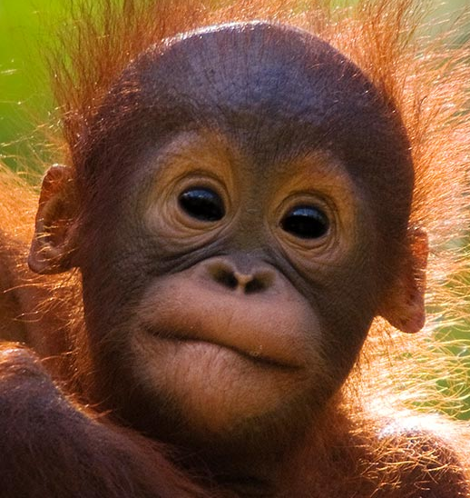
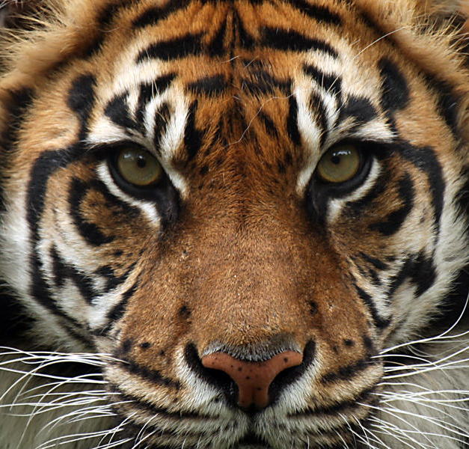
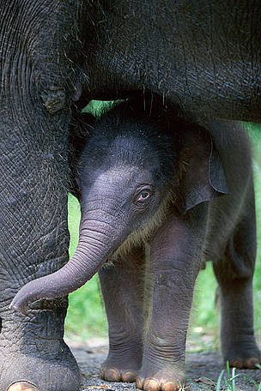
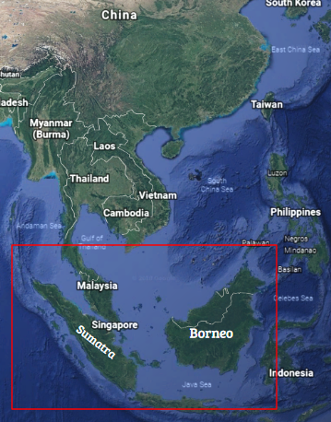
Rainforest
An area with high yearly rainfall and average temperatures is called a rainforest.
A rainforest is basically a warm and wet forest.
Rainforests are generally found around the equator and have incredible biodiversity.
Rainforests cover 6% of the Earth’s surface but are home to over 50% of known species.
Rainforest species include the Bornean orangutan, the tiger, and the Asian elephant.
These species live on the East Asian islands of Sumatra and Borneo.

Slide 5

Activity
Read the article, The Intelligent Orangutan, then answer the questions about orangutans. Follow up by exchanging papers with the person sitting next to you and grading each others’ papers.

Slide 6

Discussion
Discuss in small groups what deforestation is and why it may occur.
Discuss as a class.

Slide 7
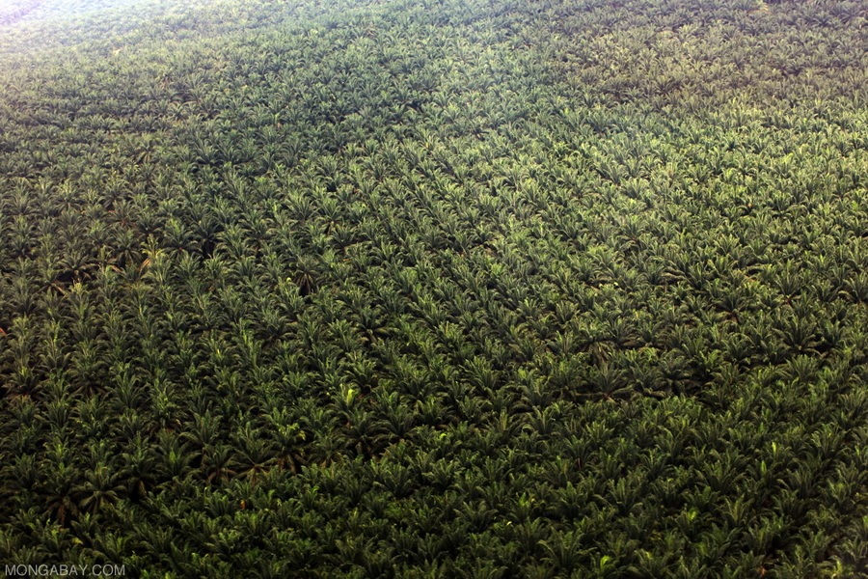
Deforestation
Deforestation is just what it sounds like- destruction of forest.
In Borneo and Sumatra, rainforest is being destroyed for pulp-and-paper development, logging, and palm oil plantations.
Palm oil is an oil derived from palm fruit.
If you’re like most Americans, you probably eat and use more than 18 grams of palm oil every day, which is approximately the weight of a fully grown mouse.
Palm oil is in over 50% of grocery store products, including snack food, cleaning items, lowfat milk, pet food, and even biodiesel.
By using and eating palm oil, you are indirectly destroying rainforest.

Slide 8
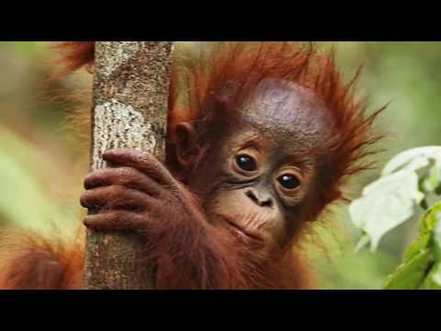

Slide 9

Discussion
In small groups, discuss what the three points from the video.
  avoiding palm oil
  pressing for sustainability
  spreading the word
Hypothesize what you can do to accomplish each one.
Discuss as a class how your efforts would help save the rainforest.

Slide 10
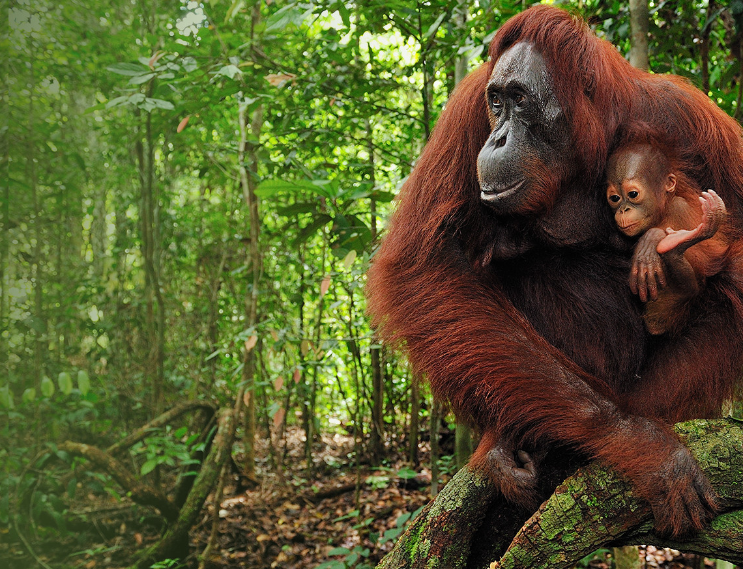
Conservation
Conservation is a general term used to describe protection and preservation of natural areas and species.
So what do those three conservation points in the video actually mean?
Avoiding palm oil means simply buying less from companies that use it or its derivatives (ingredients made from it).
Pressing for sustainability means talking to these companies and telling them that they are destroying rainforest.
Spreading the word means telling your family and friends about the issue. Tonight, tell your parents, and see if you can tell three of your friends!

Slide 11

Research
Your teacher will now pass out the articles again. The other side of the paper is your homework.

Slide 12
Thanks for saving the rainforest today!
For more information, please visit www.orangutangang.org

