Slide 1
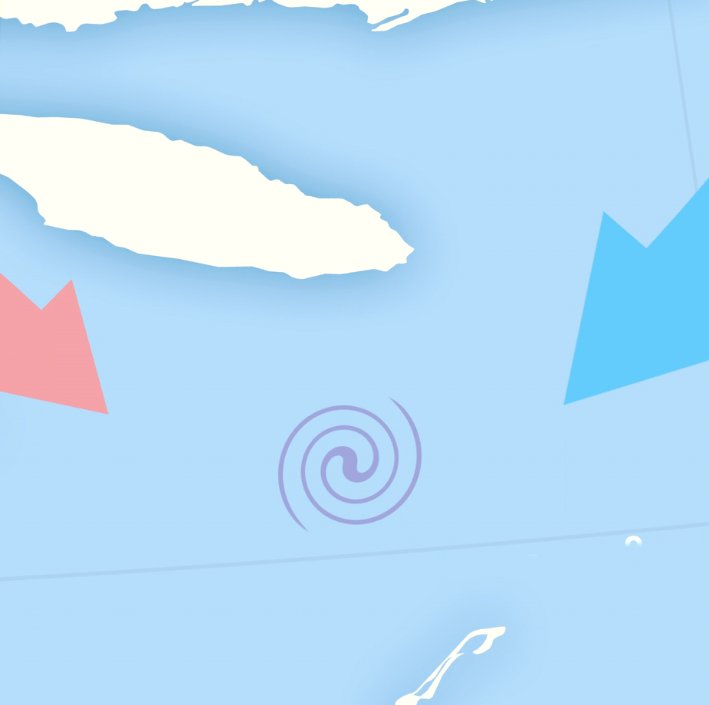
STIRRING THE ZONE
North Atlantic Ocean
What’s so great in the Gulf for a right whale or a gannet?

Slide 2
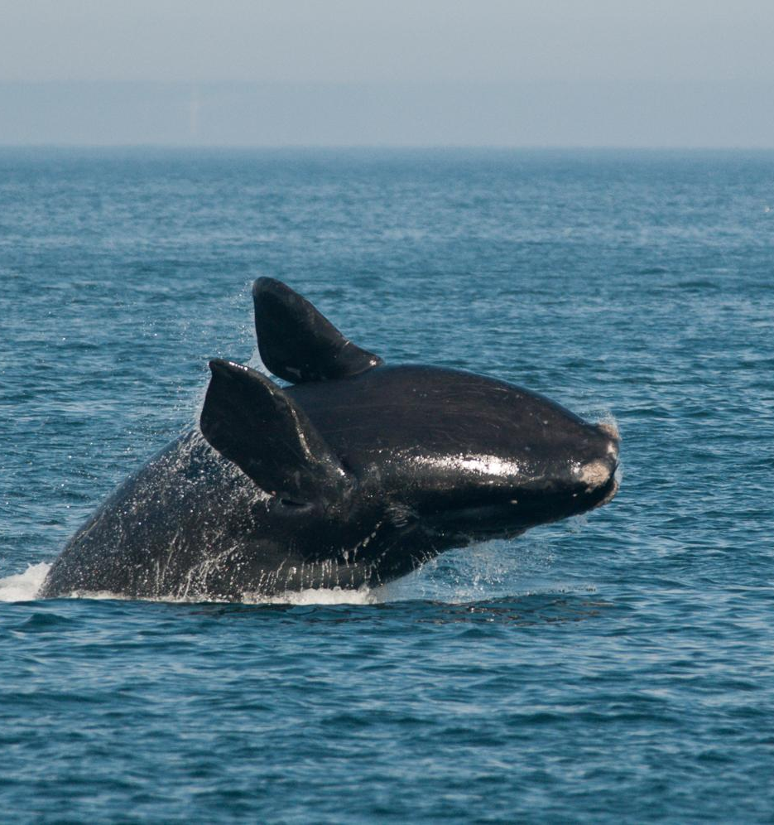
Here’s your challenge:
Imagine you are a right whale or a gannet living in the Gulf of the Saint Lawrence. Create a poster or video advertisement for a new roommate.
Here’s your to-do list:
Step 1
Start by writing down some key habitat features such as upwelling or nutrient run-off to entice other whales or gannets to come to your habitat.
Step 2
Create your poster or video. Include some of the key habitat features you listed.
Step 3
Review your poster or video - what can be improved?
Step 4
Share your ad with a friend for feedback!

Slide 3
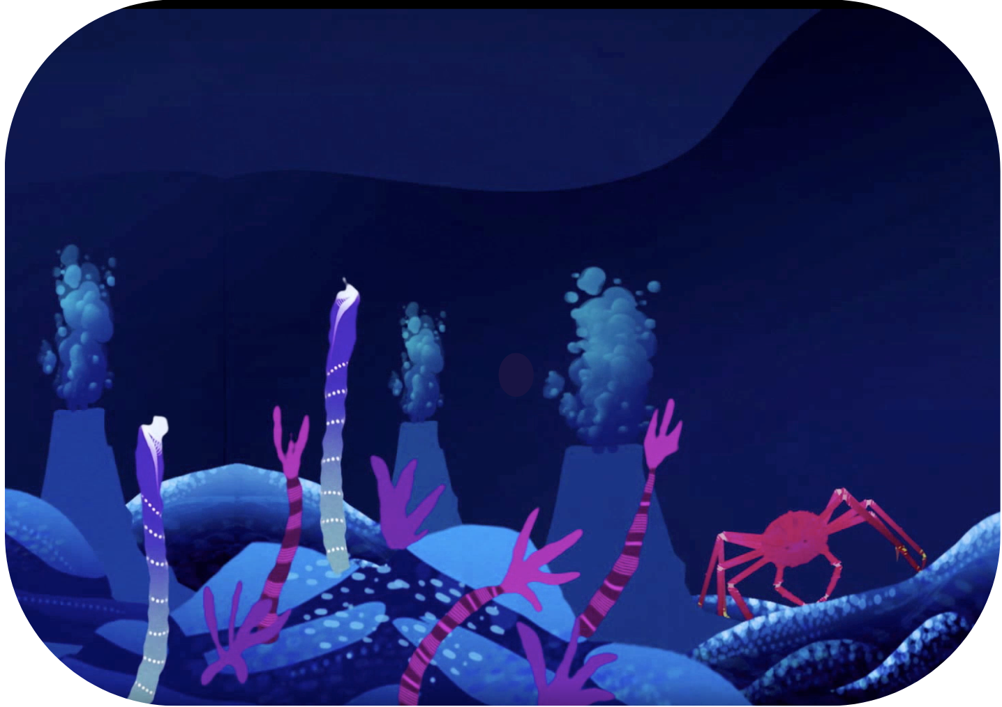
Time to research!
What are some key habitat features of the Gulf of the Saint Lawrence
Not sure of the answer?
Here are some websites to get you started:
Oceana - The Wonders of the Gulf of St. Lawrence
Gulf of St Lawrence

Slide 4
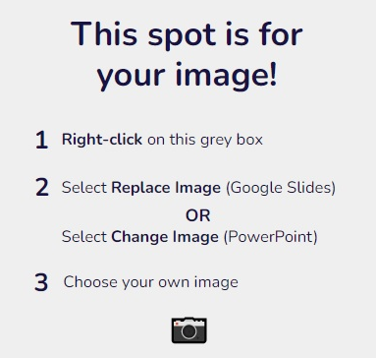
Poster template
[Poster tagline]
POSTER TITLE
[Habitat feature 1]
[Habitat feature 2]
[Habitat feature 3]

Slide 5
Video storyboard

