Slide 1
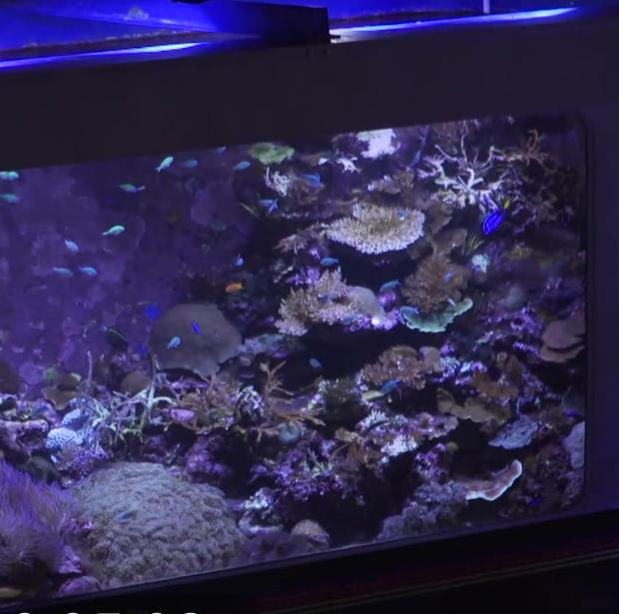
SIMULATING THE SEA
Tropical Ocean
How do scientists study coral?

Slide 2
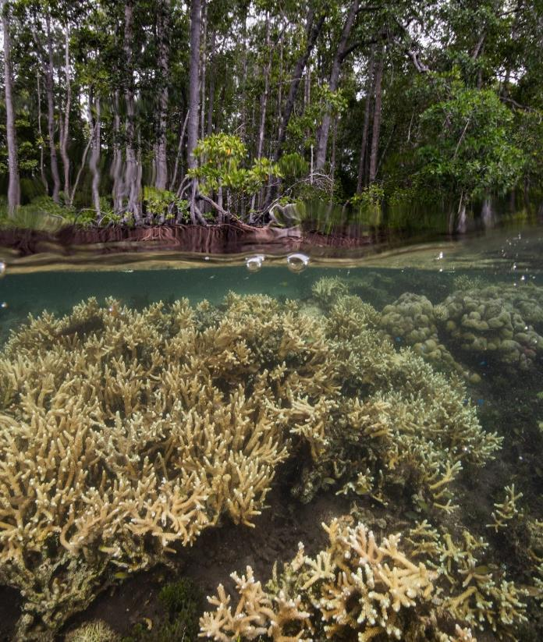
Here’s your challenge:
Design an indoor coral habitat!
Here’s your to-do list:
Step 1
Think like a SeaSim lab scientist!
Step 2
Set up an aquarium with everything corals need to live.
Step 3
Explain your decisions!

Slide 3

Introduction
Wow! I am so excited that you are here!
I am going to need some help in my lab to set up an indoor coral habitat. Are you up for the task?
Kate, Scientist
Notes:
Avatar randomly generated at: https://getavataaars.com/

Slide 4

What are we trying to find out?
Here’s an example of one of our aquariums!
I work at SeaSim!
We’re trying to figure out how to keep coral alive.
We set up our lab aquariums like models of the ocean.
We include all the things that affect how corals live, like sunlight and temperature.
We set the temperature, salinity (saltiness), and pH (acidity) based on measurements we took on the Great Barrier Reef. We want to make the habitat in the tank similar to the coral’s natural habitat.
Notes:
Image references (all images shared under the Attribution-ShareAlike 4.0 International (CC BY-SA 4.0) licence):
Acanthurus achilles (Achilles Tang) by Joanna Woerner https://ian.umces.edu/media-library/acanthurus-achilles-achilles-tang/
Acropora spp by Catherine Collier https://ian.umces.edu/media-library/acropora-spp/
Chaetodon lineolatus (Lined Butterflyfish) by Tracey Saxby https://ian.umces.edu/media-library/chaetodon-lineolatus-lined-butterflyfish/
Echinothrix diadema (Long Spined Urchin) by Jane Hawkey https://ian.umces.edu/media-library/echinothrix-diadema-long-spined-urchin/
Hermit Crab by Sander Scheffers https://ian.umces.edu/media-library/hermit-crab/
Plate coral by Tracey Saxby https://ian.umces.edu/media-library/plate-coral-1/
Platygyra spp. (Brain Coral) by Tracey Saxby https://ian.umces.edu/media-library/platygyra-spp-brain-coral/
Porites lobata (lobe coral) by Joanna Woerner https://ian.umces.edu/media-library/porites-lobata-lobe-coral/
Trochus spp. (Sea Snail) by Kim Kraeer, Lucy Van Essen-Fishman https://ian.umces.edu/media-library/trochus-spp-sea-snail/
Zebrasoma flavescens (Yellow Tang) by Joanna Woerner https://ian.umces.edu/media-library/zebrasoma-flavescens-yellow-tang/
Halophila johnsonii (Johnson's Seagrass) 1 by Catherine Collier https://ian.umces.edu/media-library/halophila-johnsonii-johnsons-seagrass-1/

Slide 5
Now it’s your turn
Ready?!
Use the corals and other living organisms and aquarium parts on
slide 7 and slide 8
to build your aquarium on slide 6!
I can’t wait to see what you build!
Kate, Scientist
Notes:
Avatar randomly generated at: https://getavataaars.com/

Slide 6
Aquarium template
Challenge: Build a habitat that corals will thrive in.
SALINITY
##
pH
##
WATER TEMPERATURE
##
Tip: You can copy and paste what you need from other slides.

Slide 7






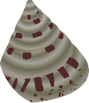
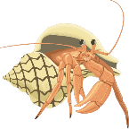
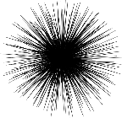

Living organisms!
Cut and paste some of these images to set up your aquarium.
Corals
Fish that eat the algae
that grows in tanks
Acropora
Coral
Plate Coral
Lobe Coral
Brain Coral
Yellow Tang
Other creatures that are important to the ecosystem
Lined Butterflyfish
Sea Snail
Hermit Crab
Long-spined Urchin
Achilles Tang
Notes:
Image references (all images shared under the Attribution-ShareAlike 4.0 International (CC BY-SA 4.0) licence):
Acanthurus achilles (Achilles Tang) by Joanna Woerner https://ian.umces.edu/media-library/acanthurus-achilles-achilles-tang/
Acropora spp by Catherine Collier https://ian.umces.edu/media-library/acropora-spp/
Chaetodon lineolatus (Lined Butterflyfish) by Tracey Saxby https://ian.umces.edu/media-library/chaetodon-lineolatus-lined-butterflyfish/
Echinothrix diadema (Long Spined Urchin) by Jane Hawkey https://ian.umces.edu/media-library/echinothrix-diadema-long-spined-urchin/
Hermit Crab by Sander Scheffers https://ian.umces.edu/media-library/hermit-crab/
Plate coral by Tracey Saxby https://ian.umces.edu/media-library/plate-coral-1/
Platygyra spp. (Brain Coral) by Tracey Saxby https://ian.umces.edu/media-library/platygyra-spp-brain-coral/
Porites lobata (lobe coral) by Joanna Woerner https://ian.umces.edu/media-library/porites-lobata-lobe-coral/
Trochus spp. (Sea Snail) by Kim Kraeer, Lucy Van Essen-Fishman https://ian.umces.edu/media-library/trochus-spp-sea-snail/
Zebrasoma flavescens (Yellow Tang) by Joanna Woerner https://ian.umces.edu/media-library/zebrasoma-flavescens-yellow-tang/
Halophila johnsonii (Johnson's Seagrass) 1 by Catherine Collier https://ian.umces.edu/media-library/halophila-johnsonii-johnsons-seagrass-1/

Slide 8













Tools
Use some of these images to set up your aquarium.
Think about which tools you’ll need to keep your aquarium habitat healthy.
To control the water:
To light:
To measure:
##
“Sunlight” lamp
Thermometer
##
“Moonlight” lamp
pH meter
Water pump
Water heater
Switches and buttons
##
Salinometer

Slide 9

Share
Explaining your work is a big part
of your job when you’re a scientist.
Share your thinking with us below!
Choose two things (a living organism or an aquarium tool) from your aquarium to explain.
Thing 1:
Thing 2:
What part of the coral’s natural habitat does this thing help to recreate?
What part of the coral’s natural habitat does this thing help to recreate?

Slide 10
Share
Explaining your work is a big part
of your job when you’re a scientist.
Share your thinking with us below!
Sometimes it’s hard to make an indoor habitat realistic. For example, the light from a lightbulb isn’t exactly like sunlight.
How is your habitat different from the natural habitat?

