Slide 1

More Reports and Resources

Slide 2

Project Overview
K-12 administrator and teacher survey
Kindergarten to Grade 12 (K-12) policy landscape analysis
Higher education policy landscape analysis
Analysis of NGO involvement in climate change education–SURVEY OPEN NOW
Pocket of innovation - case studies
K-12 policy forum

Slide 3


Under Development:
Guidelines for Empowering
Climate Change Action

Slide 4

Join us!
climateedpolicy.org
Notes:
Judy

Slide 5
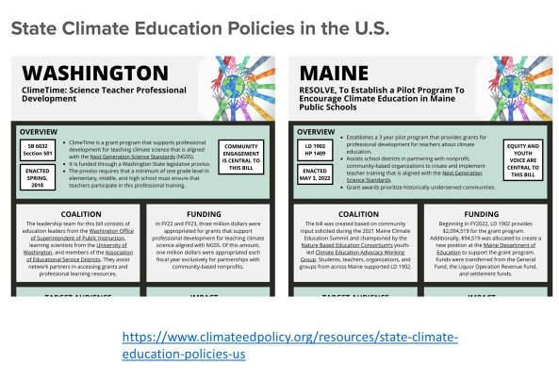
Mini-Case Studies on Climate Change Education Policy!

Slide 6
