Slide 1
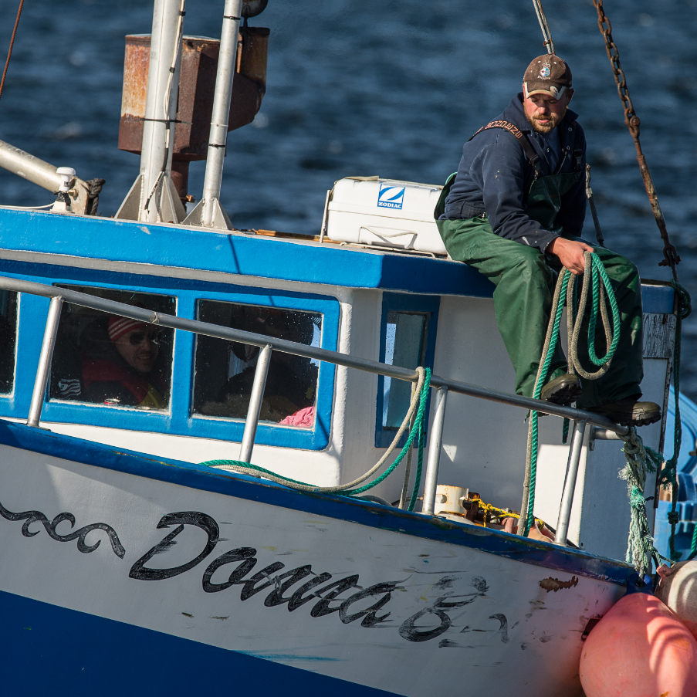


360° FISHING
North Atlantic Ocean
I used to count the lumpfish and the cod fish coming up. Just got a little bit older, I started hauling other stuff … Just learn, keep your eyes open. Stay out of danger. Watching over the years, watching me father and me grandfather. It can be exciting, the job itself.
- Michael Ford

Slide 2
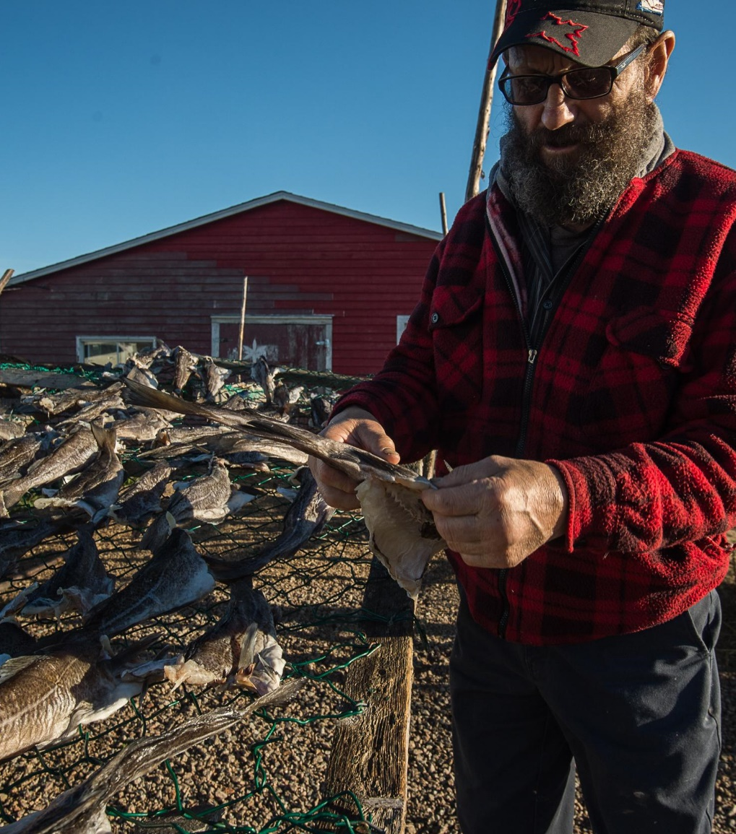
Here’s your challenge:
Write a job posting explaining what skills are needed for a fisherman or woman.
Here’s your to-do list:
Step 1
Brainstorm the skills needed for a fisherman.
Step 2
Use slide 3 to create your job posting.
Step 3
Edit your work - Have a friend read your posting to help find mistakes!

Slide 3

Job post template
JOB TITLE:
Now hiring!
Move your office to the ocean.
Job description
Skills required

